Slide 1
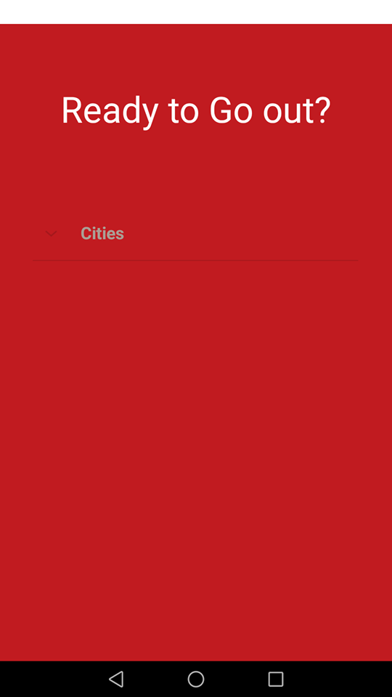
Check Before you go!
HaXanthon 2019-GBPS ΤΕΑΜ
Anagnostou Pantazis
Arzanas Ioannis
Karypidis Efstathios
Titopoulos Vasileios

Slide 2
Problem
How many times have you faced the problem of no availability at a because you didn’t make a reservation?
Have you already checked a variety of bars and restaurants but they are full of people?
Would you like to get informed about unoccupied seats before even heading off?
Our app is here for you!

Slide 3
Basic Idea
Search for available seat in a wide range of cafeterias, bars and restaurants at your city.(Refresh about every 5 minutes)
Booking potential (Depending on your choice)
Easy access to information like address,working hours, special occasions etc.
Safety of all the users’ personal information (name, telephone number) and penalties for inappropriate use of the app.
Notes:
Booking Potential εξαρτάται απο την εκάστοτε επιχειριση
Ασφάλεια Προσωπικών Δεδομένων

Slide 4
Basic Idea
Benefits for businesses’ owners(Bigger profit, advertisement, convenient ways to serve costumers)
Evaluation capability
Daily Support(Few Hours)

Slide 5
Application
Welcome
City Selection
Filters
Booking details
Business Information and Options
Selection
Booking Verification

Slide 6
Marketing Plan
Target group
Competitors
Profits for the app
Future Challenges/Possible Problems
New features

Slide 7
Competitors and Target Group
This is an innovative idea and probably there are not any known competitors at the moment.
Our target is everyone who is able to use a smartphone and especially the age group 18-40.

Slide 8
Application Profits
Businesses can use a free 30day trial of our application.
Initial setup
Different price packages depending on the features and license duration.

Slide 9
Possible/Future Problems-Solutions
Inappropriate use of the app.
Options for businesses that are usually fully occupied.
Available only for android(at the moment)
Advertisement and pop-ups
Extra Features

Slide 10
Future Challenges
Database and Navigation Instructions
Availability for more cities
Better UI experience
Free Ride option and bonus rewards
24-Hour Support
Favorite Button
AI for user preferences

Slide 11
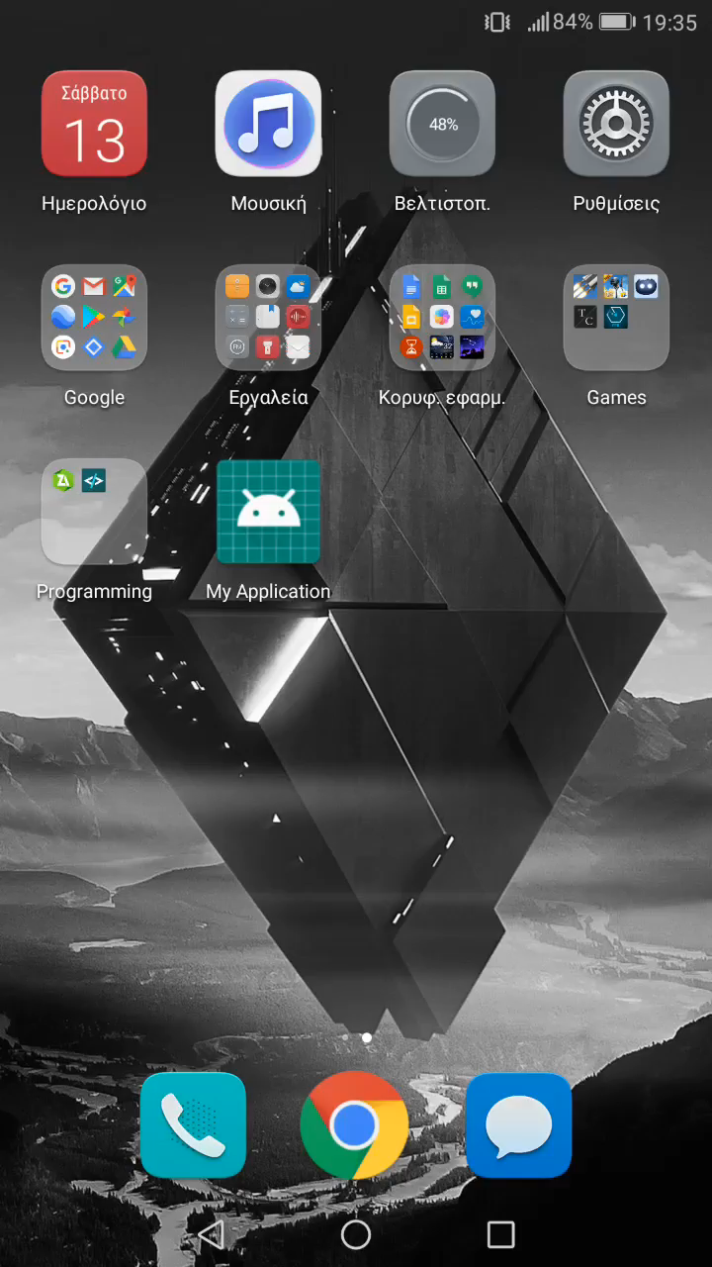
A small Demo

Slide 12
We use:
Android Studio
Azure SQL Database
Azure Maps
AI Model
Our Project is available at GitHub
https://github.com/pantanag/test?fbclid=IwAR2_xFgxUH7sKZlVNr81RQm4fN6KEUc9euZSAnSWq3wjrFfBEHTiELvJpu4
Notes:
Για την ασφαλη φιλοξενία των δεδομένων θα χρησιμοποιηθεί το Azure SQL Database ενώ για την καθοδηγηση χρηστών και τον εντοπισμό βέλτιστης διαδρομής θα χρησιμοποιήσουμε το Azure Maps και συγκεκριμένα το Routing API

Slide 13
Thank your time!
ANY QUESTIONS?
Anagnostou Pantazis ECE DUTH
Arzanas Ioannis ECE DUTH
Karypidis Efstathios ECE DUTH
Titopoulos Vasileios ECE DUTH

